Slide 1
Week 19 – AP Macroeconomics

Slide 2
Market for Loanable Funds
We previously covered the Money Market, which showed how people demand to hold liquid money and are willing to give up the interest they could have earned.
We will not look at the Market for Loanable Funds. This is all about the money that is used for lending and borrowing.

Slide 3
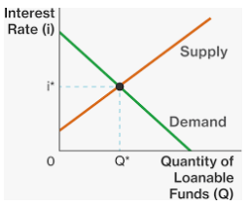
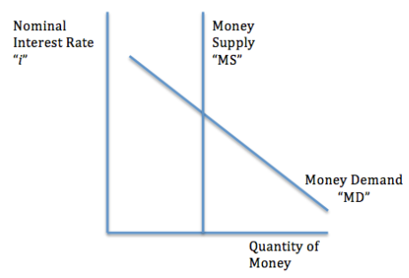
Two types of money market.
Summary
The Loanable Funds Market is all about:
Borrowing & Lending Money
Money Market
Shows how people demand cash and liquid money (M1) to be used primarily for transactions
Loanable Funds Market
Shows how people want to lend/borrow money for long term investments

Slide 4
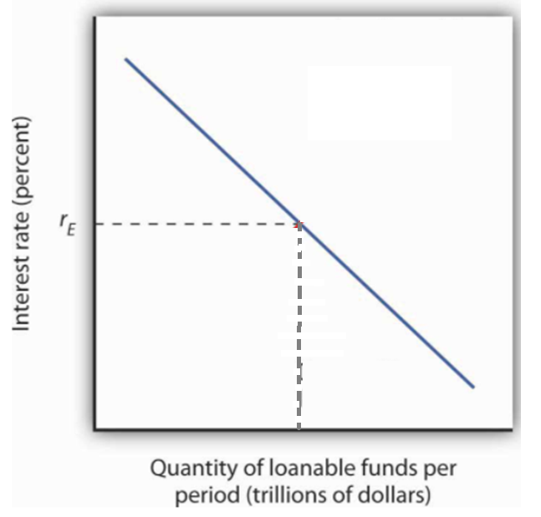
Demand for Loanable Funds
Summary
Demand for loanable funds shows how people want to borrow money (for investment and consumption) at different real interest rates (which is the cost of borrowing).
The demand for loanable funds is determined by businesses and households and governments who wish to borrow money/funds for various reasons.
  Consumers: eg. Loan for a house (mortage)
  Businesses: Loan for investment in equipment, expansion, start a business (business loan)
  Government: Infrastructure spending, Education etc. (bonds)
The cost of borrowing is the interest rate.
  A high interest rate means a higher the cost of borrowing, the lower the quantity of money that people will borrow.
  The lower the interest rate, the lower the cost of borrowing and so a larger quantity of money will be borrowed.
We can notate Demand for Loanable funds as D_{LF}
Real Interest Rate
These are high value users; people who will borrow even if the interest rate is high.
Borrowers won’t have to pay as much interest.
More people will borrow for investment purposes.
D_{LF}
Real Interest Rate
The market for loanable funds is more long term in nature.
Because people who borrow money are concerned about future price levels (because this will affect how much they must pay out), we use the real interest rate.

Slide 5





Rate of Return and Interest Rate Examples
High Interest Rate eg. 10%
Low Interest Rate eg. 3%
A real estate company borrows money to build a new block of apartments.
Amount: $10 million
Rate of Return = 20%
This project will go ahead because the rate of return offsets the cost of borrowing.
This project will go ahead because the rate of return offsets the cost of borrowing.
A mining company borrows money to buy a new earth mover.
Amount: $5 million
Rate of return = 9%
This project will NOT go ahead because the rate of return is not enough to offset the cost of borrowing.
This project will go ahead because the rate of return offsets the cost of borrowing.
A computer store borrows money for a delivery van.
Amount: $100,000
Rate of return = 5%
This project will definitely NOT go ahead because the rate of return is far below being enough to offset the cost of borrowing.
This project will go ahead because the rate of return offsets the cost of borrowing.
Total Borrowing/Lending = $10 million
Total Borrowing/Lending = $10 million + $5 million + 100,000 = $15.1 million

Slide 6
What is the relationship between the quantity demanded of loanable funds and the interest rate.
It is negative, because the higher the interest rate, the higher the cost of borrowing. This makes businesses, consumers and government less likely to borrow money.

Slide 7
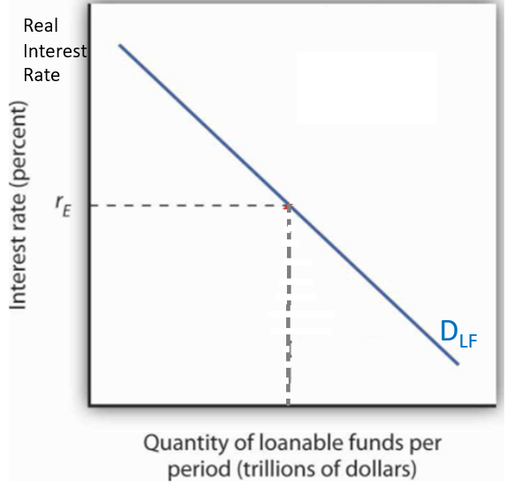
Draw the market for loanable funds graph with a D_{LF}. Be sure to label the axes correctly.

Slide 8
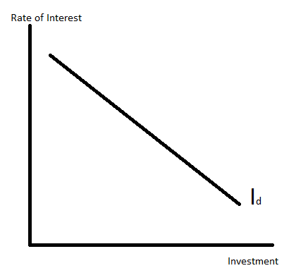
The Investment Curve and Interest Rates
The demand for loanable funds also includes investment, which is sometimes represented by its own investment curve.
This shows a similar relationship;
  If interest rates are high, firms will invest less.
  If interest rates are low, firms will invest more.
This is because firms will be scared that they will lose money on their investment if they have to pay too much interest.
Summary
The investment curve is part of the demand for loanable funds curve.
  Investment is one of the reasons why people want to borrow
It shows a negative relationship between interest rate and amount of investment.
This is because lower interest makes it cheaper for firms to borrow, so they are less likely to lose money on their investments.

Slide 9
What is the relationship between interest rate and investment?
A negative relationship, because interest increases the cost of borrowing, which makes firms less eagre to borrow for investment purposes.
If a firm’s investment will gain 5% on the money they borrowed but they must pay 6% interest, will the project go ahead?
No, the project won’t go ahead because the business project will make less money than the interest rate. Therefore, the project will lose money.

Slide 10
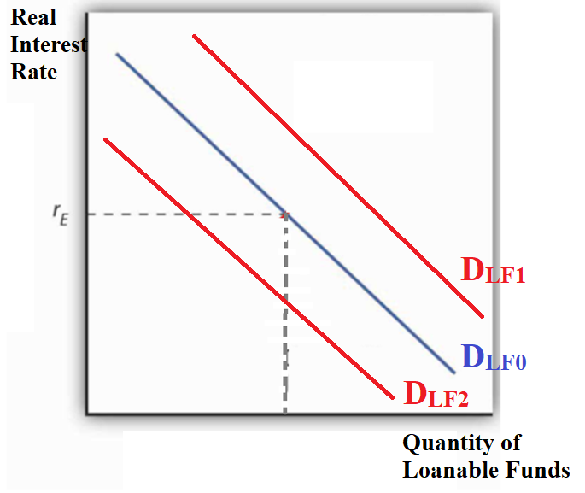
Shifters of Loanable Funds Demand
Summary
Improved ROI (Return on Investment) will increase demand for loanable funds D_{LF}
The demand for loanable funds curve can also shift left or right.
Anything that changes the behavior of investors, borrowing households and borrowed government spending will change D_{LF}.
  Economic confidence - If the economy is doing well people may be more optimistic about the economy and expect greater returns from their investments. Conversely, low confidence will decrease demand.
  New technology – if technology improves than business investment will yield higher returns.
  Rate of Return on Investment – if there are new opportunities for investment, eg. An increase in the car industry in a country, then this will increase the demand for borrowed money.
  Government Subsidies – subsidies for business investment will naturally increase the rate of return for businesses on top of their existing rate of return.
  Government Budgets – if the government has a budget deficit, they will need to borrow more and if they have a budget surplus they will borrow less.
Note: As always, the y axis variable (in this case the real interest) will move us along the same curve but not shift the entire curve.

Slide 11
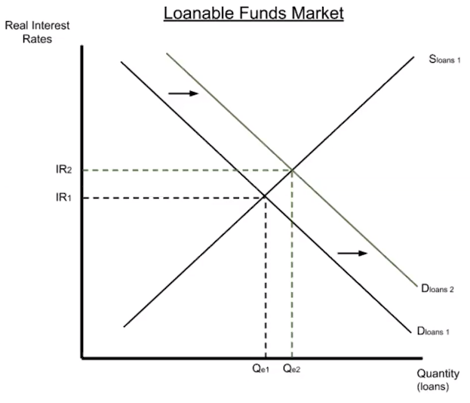
New technology improves the productivity of farming equipment. What will happen to investment and the demand for loanable funds.
The improved efficiency will increase the rate of return on farming equipment which will lead to an increase in investment. This will increase the D_{LF.}

Slide 12
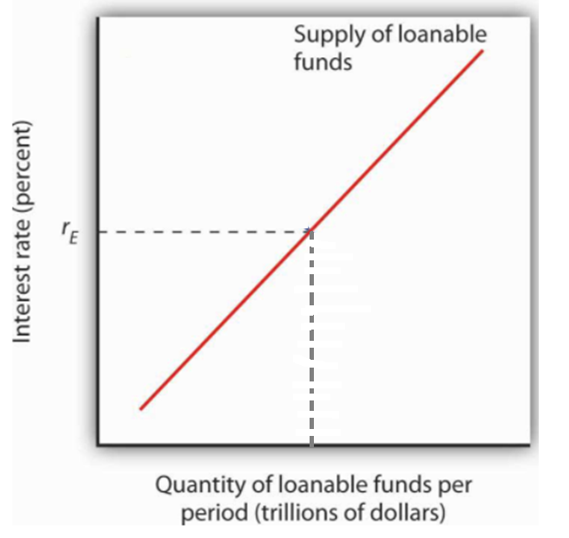
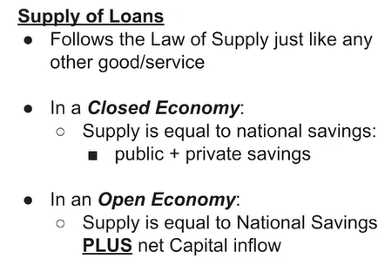
Supply for Loanable Funds
Summary
Supply of loanable funds is money that is saved and lent out to earn interest.
Higher interest will mean more money will be saved.
Supply of loanable funds is money that is saved for the purpose of lending and earning interest
The interest rate is the reward for lending money.
  High interest rate = people will save more money = more money for lending
    This is because you will earn more interest and so there is a stronger incentive
  Low interest rate = people will save less money = less money for lending
    This is because you will earn less interest and so there is a weaker incentive to save.
r_{high}
r_{low}
This means that foreigners can provide money to be borrowed.

Slide 13
What is the relationship between the real interest and quantity of money that people will lend?
There is a positive relationship.
This is because the higher the interest rate, the more interest people will earn, which incentivizes people to save more money.
Where does loanable funds supply come from?
They come from private savings from businesses and households.
They also come from public savings if the government has extra money.
Foreigners can also lend money.

Slide 14
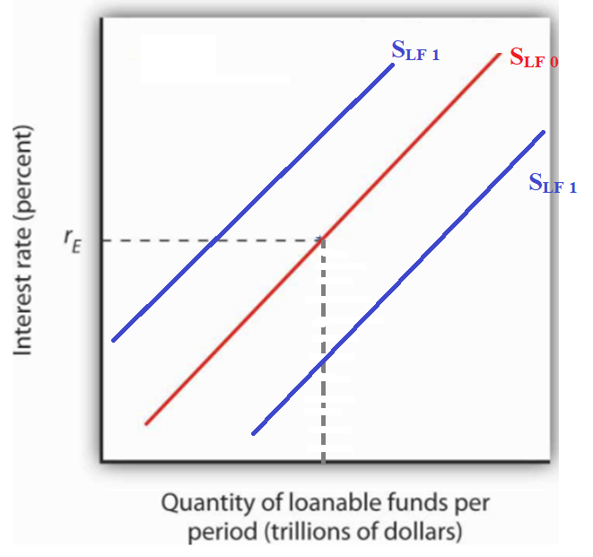
Shifters of Supply
Note: As always, the y axis variable (in this case the real interest) will move us along the same curve but not shift the entire curve.
Summary
Change in saver behaviour will change the supply of loanable funds D_{LF}
  Supply of Loanable funds can increase (shift right) or decrease (shift left) when certain factors change.
  Anything that affects the behavior of savers will affect the S_{LF.}
  Factors (that will affect saver behavior):
  Change in Real GDP/ Wealth – when consumer wealth increases, people have more money to save.
Performance of other markets - if investors believe they can make more money investing in other assets (stocks, property etc.) then they will save less money and try to get higher returns elsewhere
  Eg. Other foreign loanable funds markets, stock market, commodities market
Change in MPC – consumers for different reasons may see a change in their MPC. This will affect how much they save.
Capital Inflows – this refers to foreigners who lend money and expect to be repaid with interest.

Slide 15
National Savings and Loanable Funds
Total Supply of Loanable Funds = National Savings + Foreign Savings
Supply of loanable funds comes from entities who put money in the banking system.
In a ‘closed economy’ with no foreign involvement, the supply of loanable funds comes from national savings only
However, in an ‘open economy’ we consider the savings of foreigners also
(Households and Firms)
National Savings = Private Savings + Public Savings
(Government)
Summary
S_{LF} = National Savings + foreign savings (open economy)
S_{LF} = National Savings (closed economy)
National savings = Public Savings + Private Savings

Slide 16
What is the effect of an increase in the MPC on the supply of loanable funds?
Savings will decrease which means that the supply of loanable funds will decrease (shift to the left).
What is the effect of a decrease in capital inflows due to fear of financial problems in the country on the supply of loanable funds?
Foreign investors will be scared of lending money in the country’s financial system. Therefore there will be a decrease in the supply of loanable funds (shift to the left).
What is national savings made up of?
Private savings (firms and households) and Public savings (government)

Slide 17
What will be the effect on Demand/Supply for Loanable Funds?
People start saving in case the pandemic causes parts of the economy to shut down.
Answer: Increase in supply of loanable funds.
Consumers have to dip into savings to make up for the lost wages due to reduced working hours.
Answer: Decrease in supply of loanable funds.
People start buying more houses as a result of a property boom.
Answer: Increase in demand for loanable funds.
Businesses aren’t investing as much new capital because of low business confidence.
Answer: Decrease in demand for loanable funds.

Slide 18
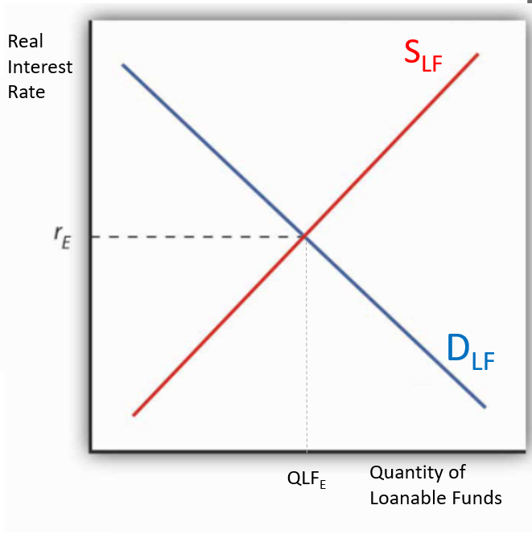
Loanable Funds Equilibrium
Summary
Equilibrium will naturally occur in the market with an equilibrium Real Interest Rate and Q_{LF} demand = Q_{LF} supplied (Borrowed money = Lent money)
What the market graph shows:
Loanable funds means money that is lent out to businesses for investment and households for big purchases.
The market will naturally reach an equilibrium with an equilibrium Real Interest Rate where Q_{LF} demanded = Q_{LF} supplied.
Real Interest Rate
Loanable funds market deals with long term thinking unlike the money market which is short term.
The interest rate is the real interest rate, because we assume that for long term investing, investors (who think long term) take inflation into consideration and are therefore only concerned with the real interest rate (= nominal interest – inflation).
Disequilibrium
If the interest rate that savers give to borrowers is too high, then there will be a surplus of loanable funds.
If the interest rate that savers give to borrowers is too low, there will be a shortage because more people will want to borrow than people want to lend.
In either situation, the real interest rate will change so that the shortage or surplus is corrected.

Slide 19
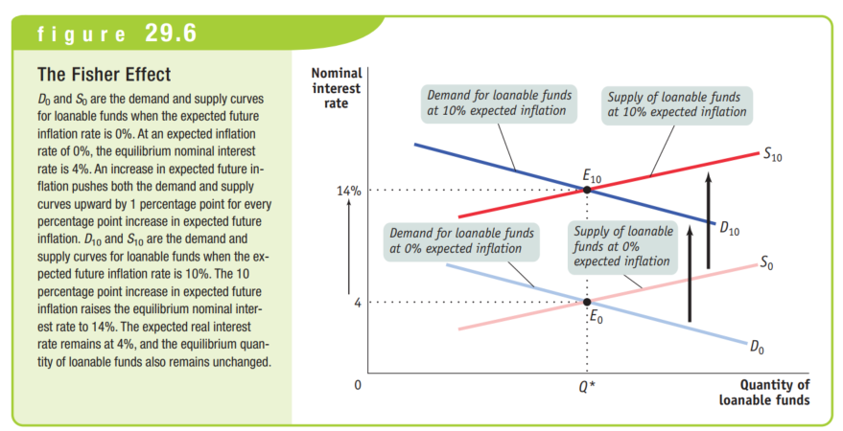
We can see how the loanable funds market would appear if it used the nominal interest rate. This is simply showing how the Fisher Effect applies to the loanable funds market. The Nominal Interest Rate will be higher as expected inflation increases.

Slide 20
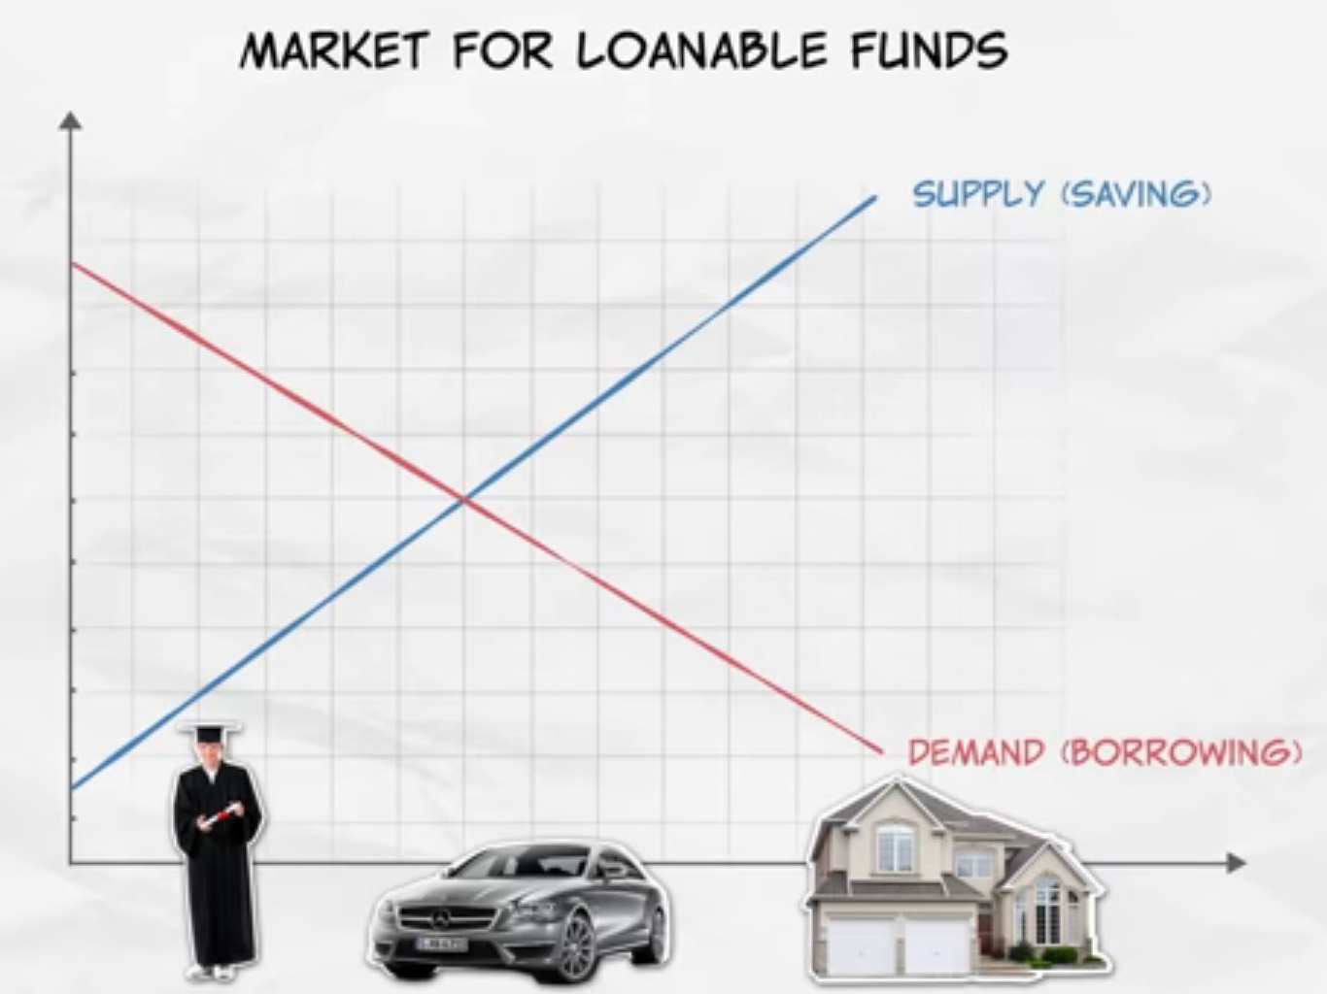
Investment and Loanable Funds Market
https://youtu.be/L-GouzQaAno?t=305
MRU video

Slide 21
Why do we assume that the market for loanable funds uses the Real Interest Rate and not the Nominal Interest rate like in the Money Market.
The market for loanable funds is about long term decision making. Therefore, borrowers and lenders try to predict future inflation because this affects the real interest rate.

Slide 22
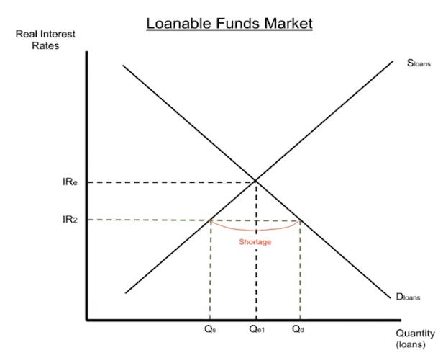
If many people are willing to borrow money but not many people are willing to lend, what does this say about the market for loanable funds?
When Q_{LF} demanded is more than Q_{LF} supplied, we are in a disequilibrium. Specifically we have a shortage of loanable funds which means the real interest rate is too low. The real interest rate will increase to create an equilibrium.
IR will move from IR2 to IR1.

Slide 23

Module 29
This describes a disequilibrium. The market interest rate will soon adjust so that borrowing = lending.

Slide 24

Module 29
A) Real interest = unchanged because determined by the Demand and supply of loanable funds which controls for inflation.
b) the nominal interest rate will be increased to maintain the real interest rate.
C) the quantity of loanable funds will be unchanged because the D_{LF} and S_{LF} has not shifted.

Slide 25

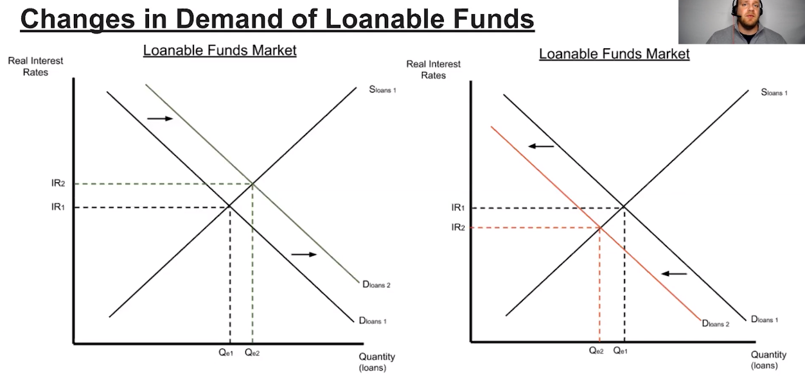
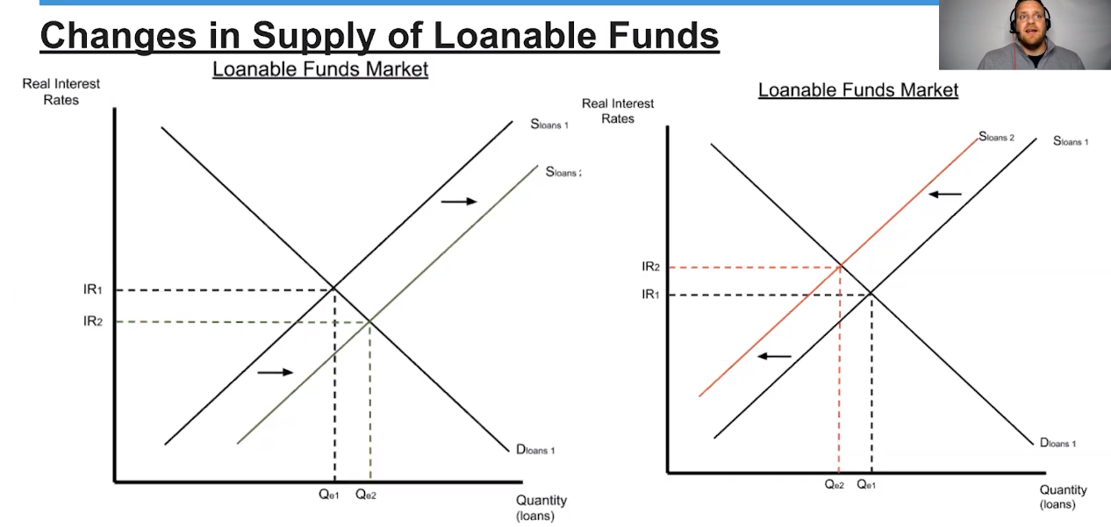
Change of Equilibrium and Effect on AD
The loanable funds market equilibrium can change from changes in demand or supply (or both).
This will lead to a change in the real interest rate and the quantity of loanable funds loaned/borrowed.
Consequences for the Macroeconomy
The equilibrium of funds loaned shows the amount of investment and interest sensitive consumption.
Therefore, an increase will lead to an increase in C and I
↑Quantity of Loanable funds means ↑Investment/Consumption/Government Spending → ↑ AD
↓ Quantity of Loanable funds means ↓Investment/Consumption/Government Spending →↓AD

Slide 26
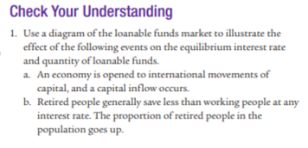
Module 29
A) Increase S_{LF} which will increase quantity and decrease the interest rate.
B) Decrease S_{LF} which will decrease quantity and increase the interest rate.

Slide 27
Market For Loanable Funds Summary
Demand for Loanable Funds (D_{LF})
  Businesses and individuals who want to borrow money.
    Reasons: to invest in projects with a rate of return > interest rate, to buy expensive goods such as cars/houses
  High real interest →↓Quantity Loans Demanded (Negative R’ship)
Supply for Loanable Funds (S_{LF})
  Businesses and individuals who wish to lend money.
    Reasons: to earn interest!
  High real interest →↑Quantity Money Loaned (Positive R’ship)
Real Interest Rate
  Because lending money and borrowing money occurs over a longer period of time, the expectations of inflation are relevant. Therefore we consider the Real Interest (Real Interest = Nominal – Inflation)
Factor | Effect on S_{LF}
Real Interest Rate | ↑→Movement right on the same curve ↓→Movement left on the same curve
Consumer Income | ↑→↑S_{LF} (more money saved) ↓→↓S_{LF}
Performance in other markets (eg. Stock market, property market) | ↑→↓S_{LF} (people will invest in other markets) ↓→↑S_{LF}
Tax on interest earnings | ↑→↓S_{LF} (lenders earn less) ↓→↑S_{LF}
Factor | Effect on D_{LF}
Real Interest Rate | ↑→Movement right on the same curve ↓→Movement left on the same curve
Rate of Return/Rate of Return | ↑→↑D_{LF} (investment is more worthwhile) ↓→↓D_{LF}
Economic Confidence | ↑→↑D_{LF} ↓→↓D_{LF}
Government Budget | Deficit →↑D_{LF} Surplus →↓D_{LF}

Slide 28
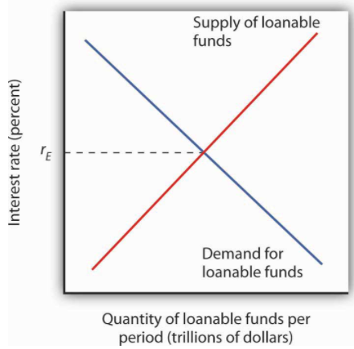
Money Market vs Loanable Funds Market
Money Growth and Inflation- Macro Topic 5.3 - YouTube
Liquid Money used for all purposes
Borrowing and Lending of Money
Shows the amount of AD = C + I + G + (X-M)
MD Shifters: Price Level, National Wealth, AD
MS Shifters: Federal Reserve Policies
The amount of M1 money
Short term decision making– therefore inflation doesn’t matter, therefore nominal interest rate
Shows the amount of C_{interest sensitive} + I + G_{borrowed}
D_{LF} Shifters: factors that affect investor behaviour
S_{LF} Shifters: factors that affect saver behavior
Shows less liquid money
Long term decision making– therefore inflation matters – therefore real interest rate

Slide 29
Module 29 Questions

Slide 30

Module 29 Questions
Answer: C
Rate of return should be larger than the interest rate or the project is not worthwhile.

Slide 31
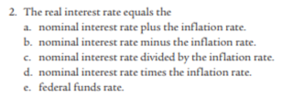
Module 29 Questions
Answer: b
Fisher Effect:
Real Interest = Nominal – Inflation

Slide 32


Module 29 Questions
Answer: b
More business opportunities make businesses more likely to invest, which in many cases will require borrowing.

Slide 33
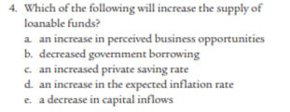
Module 29 Questions
Answer: C
Private savings are part of the supply of loanable funds. This means households. The government and foreigners can also save in the loanable funds market.

Slide 34
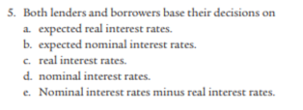
Module 29 Questions
Answer: A
Expected means what people predict. Because people cannot completely accurately predict the future, it may differ from the actual real interest rates.
Note: the same is true for expected inflation – it is what is predicted but may not be correct.

Slide 35

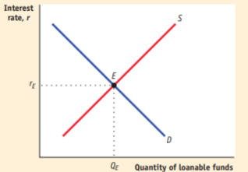
Module 29 Questions

Slide 36
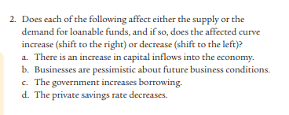
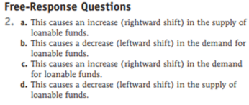
Module 29 Questions

Slide 37
Monetary Policy Effect on the Market for Loanable Funds

Slide 38
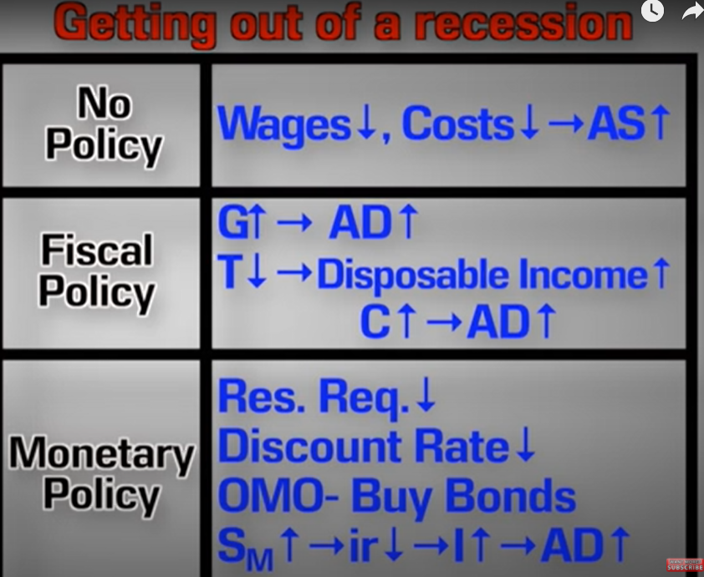
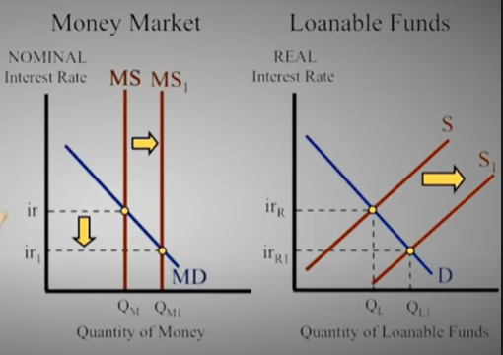
Expansionary Monetary Policy
Revision: The effects of MP on the rest of the economy:
What happens in the fund when there is expansionary monetary policy in the money markets?
Summary
↑MS→↑C,→↑AD→↑RGDP→↑Wealth→↑Saving→S_{LF}↑
The increase in money held in the money market for transactions means people will spend more, leading to higher incomes and so more money to save, increasing the Supply_{LoanableFunds}.
Note: The reason that spending is connected to incomes is based on the spending multiplier and the concept that ‘one person’s spending is another person’s income’ from Unit 3.

Slide 39
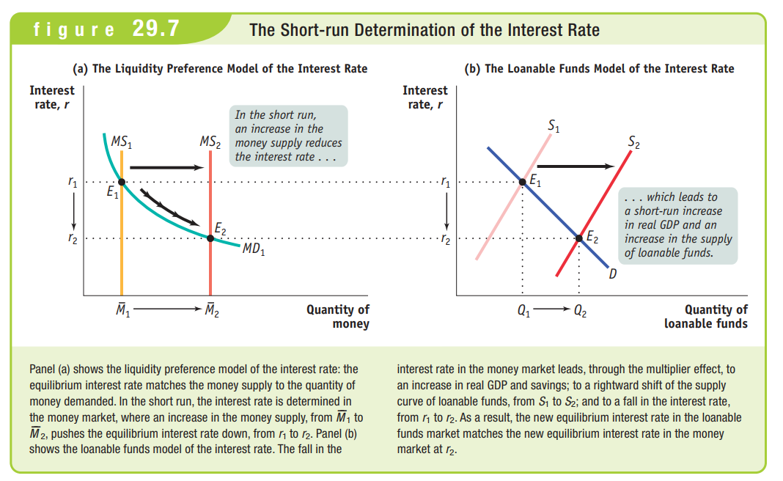

Slide 40
What effect does an increase in MS (expansionary MP) have on the market for loanable funds?
An increase in money supply, decreases the interest rate which causes more spending (C and I) in the economy. Because of this spending, people’s incomes will be higher and so they will have more money to spend.
Side Note: This idea of spending more making everyone richer is sometimes referred to as the ‘paradox of thrift’.

Slide 41
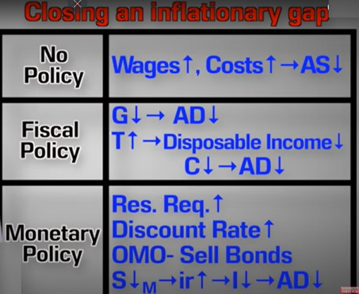
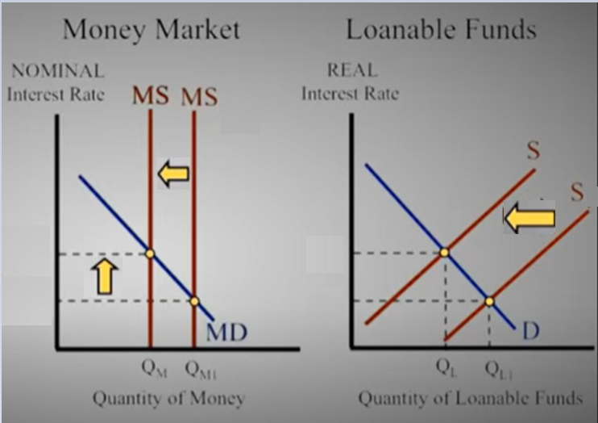
Contractionary Monetary Policy
Revision: The effects of MP on the rest of the economy:
What is the effect on the market for loanable funds when the Central Bank/Fed implements contractionary MP?
Summary
↓MS→↓C→↓ AD→↓RGDP→↓Wealth→↓ Saving→↓S_{LF}
The decrease to money supply for transactions causes less spending, lower incomes and therefore people have less savings, lowering Supply_{LoanableFunds}.
Note: The reason that spending is connected to incomes is based on the spending multiplier and the concept that ‘one person’s spending is another person’s income’ from Unit 3.

Slide 42
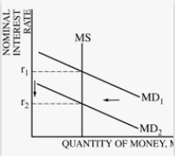
Interest Rates in the Markets for Money
The interest rate in the two markets will generally move together.
The real interest rate which is used in the Market for Loanable Funds simply accounts for inflation compared to the nominal interest rate in the money market.
If a question asks you to calculate ‘two different interest rates in the economy’ you can probably assume they are asking you to draw the Money Market and the Market for Loanable Funds.
Summary
The nominal interest rate and real interest will move together.
If a question asks about ‘two interest rates’ then you can assume they refer to the loanable funds and money market.
Note: The interest rate from the Money Market will correspond to a level in the market for loanable funds.
Real Interest Rate

Slide 43
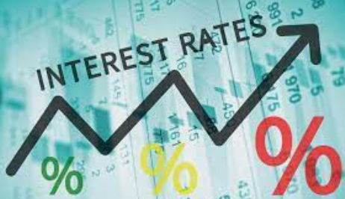
Interest Rates are connected
While we have distinguished between the nominal interest rate in the money market, and the real interest rate in the loanable funds market, the two will generally move up and down together (except in the case of inflation where only the real interest will be affected).
So if there is a change in the nominal interest rate in the money market we can also assume there is a change in the market for loanable funds.
Question examples:
  You will notice in some of these questions, even if the IR has increased in the loanable funds market, that the government can reduce the interest rate by increasing money supply in the money market.
Also called liquidity preference model (because it shows how much people demand liquid money)
Summary
Whether in the Money Market or Loanable funds market, we can often treat the interest rate in both as one interest rate.

Slide 45
What causes RIR in the loanable funds market to decrease when there is a decrease in the interest rate in the money market caused by increased MS?
The lower interest rate leads to more spending in the economy, which, due to the spending multiplier, leads to higher incomes. With higher incomes people have more money to save, therefore increasing the supply of loanable funds.

Slide 46
Last 3 Topics Summary – Money Markets, 3 Tools of MP, Ample Reserves Monetary Policy, Loanable Funds Market

Slide 47
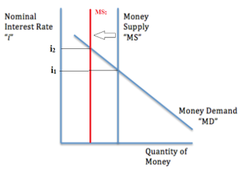
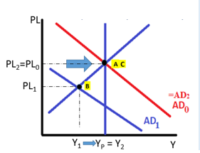
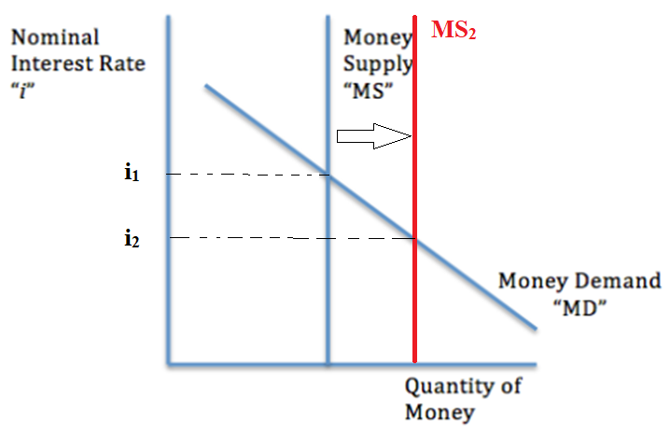
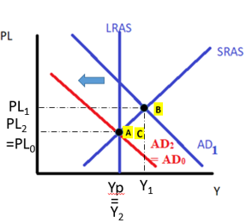
Money Market Summary
Contractionary Monetary Policy
↓ Money Supply, ↑ Interest Rates
↓C↓I
Money Demand (MD)
  The demand to hold liquid money.
    Reasons: Transactions, to hold as an asset
  ↑Interest Rate↓Quantity of Money demanded (negative relationship)
  Shifters: ∆Price Level, ∆National Income, ∆ Bank Technology, ∆AD
Money Supply (MS)
  The supply of money which is controlled by the Federal Reserve which is why it is vertical.
  Shifters: Increases or decreases in MS are made by the Fed
Nominal Interest Rate is used in this model
  The Money Market is a ‘short term’ market and inflation is not a factor in the short run.
Expansionary Monetary Policy
↑Money Supply, ↓Interest Rates
↑C ↑I

Slide 48

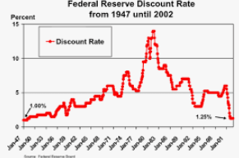

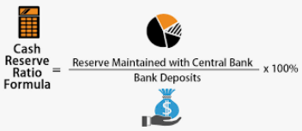
Three Tools of Monetary Policy
How does the government and Fed actually affect implement their policy?
Three Tools of Monetary Policy
Open Market Operations (OMO)
  Buy bonds = increase the money supply -> decrease the interest rate
  Sell Bonds = decrease the money supply -> increase interest rate
  Remember: Buy Bonds = Big (increase money supply), Sell Bonds = Small (decrease money supply)
3. Discount Rate and Federal Funds Rate
  Increase Discount Rate or Federal Funds Rate – decrease the money supply -> increase interest rate
  Decrease Discount Rate or Federal Funds Rate – increase the money supply -> decrease interest rate
2. Required Reserve Ratio (RRR)
  Increase RRR – decrease the money supply -> increase interest rate
  Decrease RRR – increase the money supply -> decrease the interest rate
Required
Securities = bonds
(or any other financial assets)

Slide 49
Monetary Policy Tools Summary #1
↓ Money Supply, ↑ Interest Rates
Contractionary Monetary Policy
Contractionary Monetary Policy Tools
Open Market Operations (OMO) – Sell bonds → money leaves money supply →
↑ Required Reserve Ratio → Less money available for borrowing/lending →
↑Discount Rate or Federal Funds Rate→ ↑ Cost of borrowing → ↓Bank borrowing/lending →
↓C↓I
Expansionary Monetary Policy
↑C ↑I
Expansionary Monetary Policy Tools
OMO – Buy Bonds → new money enters money supply →
↓Required Reserve Ratio→ More money available for borrowing/lending →
↓Discount Rate or Federal Funds Rate→ ↓Cost of borrowing → ↑ Bank borrowing/lending →
↑Money Supply, ↓Interest Rates

Slide 50
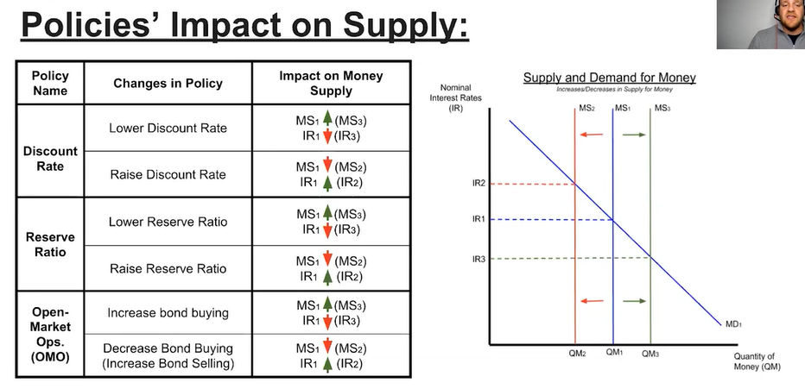

Monetary Policy Tools Summary #2

Slide 51
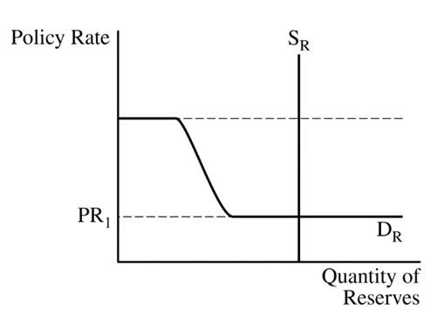
Monetary Policy (Ample Reserves Economy)
Deeply understanding this section is more difficult than understanding the bare minimum to answer the questions.
With an ample reserves economy we have to consider this Reserves Market Graph.
Policy Rate (PR) – in the US, the Federal Funds Rate (FFR), the rate that banks pay when they lend to each other.
Policy Rate
Discount Rate (DR) – rate that commercial banks pay to borrow from the Fed.
Eg. 6%
Administered Interest Rates
Interest on Reserves (IOR) – rate that the Fed pays to banks for keeping reserves.
Eg. 0.5%
Most important thing for you:
The Fed can influence the Policy Rate (FFR):
Expansionary MP – lower the IOR and Discount Rate -> lowers the PR (FFR)
Contractionary MP – increase the IOR and Discount Rate -> increases the PR (FFR)

Slide 52
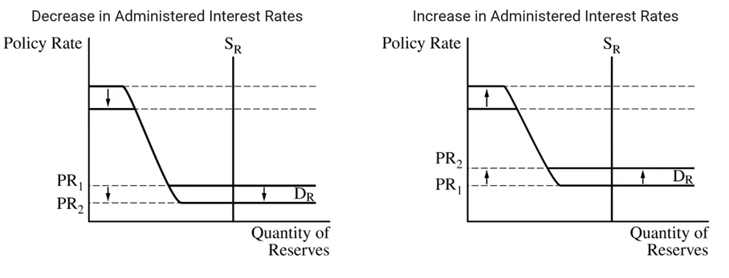
Most important thing for you:
The Fed can influence the Policy Rate (FFR):
Expansionary MP – lower the IOR and Discount Rate -> lowers the PR (FFR)
Contractionary MP – increase the IOR and Discount Rate -> increases the PR (FFR)
Expansionary MP (lowering IR)
Contractionary MP (increasing IR)

Slide 53
Monetary Policy Tools Summary
Limited Reserves Economy
Change the Money Supply using:
  Open Market Operations (OMO)
  Required Reserve Ratio
  Discount Rate
Ample Reserves Economy
Administered Interest Rates
  Interest on Reserves (IOR)
  Discount Rate
Will effect the market interest rate = federal funds rate = policy rate
Similarities in both cases
In both cases, the goal is still just to affect the interest rate! Therefore, lower IR = expansionary MP, higher IR = contractionary MP.

Slide 54
Market For Loanable Funds Summary
Demand for Loanable Funds (D_{LF})
  Businesses and individuals who want to borrow money.
    Reasons: to invest in projects with a rate of return > interest rate, to buy expensive goods such as cars/houses
  High real interest →↓Quantity Loans Demanded (Negative R’ship)
Supply for Loanable Funds (S_{LF})
  Businesses and individuals who wish to lend money.
    Reasons: to earn interest!
  High real interest →↑Quantity Money Loaned (Positive R’ship)
Real Interest Rate
  Because lending money and borrowing money occurs over a longer period of time, the expectations of inflation are relevant. Therefore we consider the Real Interest (Real Interest = Nominal – Inflation)
Factor | Effect on D_{LF}
Real Interest Rate | ↑→Movement left on the same curve ↓→Movement right on the same curve
Rate of Return/Rate of Return | ↑→↑D_{LF} (investment is more worthwhile) ↓→↓D_{LF}
Economic Confidence | ↑→↑D_{LF} ↓→↓D_{LF}
Factor | Effect on S_{LF}
Real Interest Rate | ↑→Movement right on the same curve ↓→Movement left on the same curve
Consumer Income | ↑→↑S_{LF} (more money saved) ↓→↓S_{LF}
Performance in other markets (eg. Stock market, property market) | ↑→↓S_{LF} (people will invest in other markets) ↓→↑S_{LF}

Slide 55
Money Market vs Loanable Funds Market
Money Growth and Inflation- Macro Topic 5.3 - YouTube
Liquid Money used for all purposes
Borrowing and Lending of Money
Shows the amount of AD = C + I + G + (X-M)
MD Shifters: Price Level, National Wealth, AD
MS Shifters: Federal Reserve Policies
The amount of M1 money
Short term decision making– therefore inflation doesn’t matter, therefore nominal interest rate
Shows the amount of C_{interest sensitive} + I + G_{borrowed}
D_{LF} Shifters: factors that affect investor behaviour
S_{LF} Shifters: factors that affect saver behavior
Shows money that is less liquid than just M1 money
Long term decision making– therefore inflation matters – therefore real interest rate

Slide 56

Budget Summary
 | +/- | Definition | Type of Fiscal Policy | Government Borrowing/Saving | Effect on Loanable Funds Market
Balanced Budget |  | Tax = Government Expenditure | Neutral FP | Borrowing/saving remains the same | D_{LF} unchanged S_{LF} unchanged
Budget Deficit | - | Tax < Government Expenditure | Expansionary FP (↓Tax↑Gov expenditure) | Borrowing increases/ Saving decreases | D_{LF} increases S_{LF} decreases
Budget Surplus | + | Tax > Government Expenditure | Contractionary FP(↑Tax↓Gov expenditure) | Borrowing decreases/savings increases | D_{LF} decreases S_{LF} increases
Affects the market for loanable funds

Slide 57
End of Unit 4
Well done for completing more than half of the AP Macro course.
Unit 3 and 4 form the foundation of this course. Hopefully, with your understanding of these units, unit 5 and 6 will be far easier.

